Slide 1

Function

Slide 2
Function
Definition
Let A and B be sets. A function f from A to B is an assignment of exactly one element of B to each element of A.
We write f(a) = b if b is the unique element of B assigned by the function f to the element a of A.

Slide 3
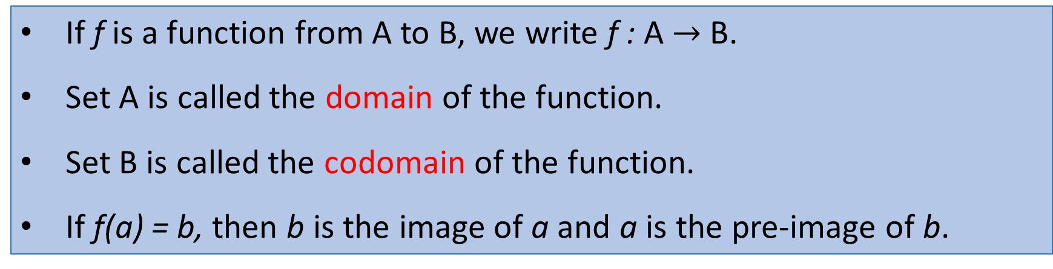
Function
If f is a function from A to B, we write f : A $→$B.
Set A is called the domain of the function.
Set B is called the codomain of the function.
If f(a) = b, then b is the image of a and a is the pre-image of b.

Slide 4
Definition of a function
Function
f : R Z
f maps R to Z
Domain
R
Z
Co-domain
f
f(4.3)
4.3
4
Pre-image of 4
Image of 4.3

Slide 5
More functions
Function
A pre-image
of 1
The image
of “a”
Domain
Co-domain
Antora
x
Asad
y
z
A
B
C
D
F
“a”
“bb“
“cccc”
“dd”
“e”
1
2
3
4
5
A class grade function
A string length function

Slide 6
Even more functions
Function
Range
a
e
i
o
u
1
2
3
4
5
“a”
“bb“
“cccc”
“dd”
“e”
1
2
3
4
5
Some function…
Not a valid function!
Also not a valid function!

Slide 7

Function and Formula
Function: Domain, Codomain
f(x) = $x^{2}$, where x $∈$ Z⁺$∧$ 0<x<2
f(x) = $x^{2}+2x$-3, where x $∈$ Z⁺$∧$ 0<x<3

Slide 8
Function arithmetic
Definition
Let f₁ and f₂ be function from A to B. Then f₁ + f₂ and f₁ f₂ are also functions from A to B defined by
(f₁ + f₂)(x) = f₁(x) + f₂(x)
(f₁ f₂)(x) = f₁(x) f₂(x)
If f₁(x) = $x^{2}$ and f₂(x) = x - $x^{2}$. What are the functions (f₁ + f₂)(x) and (f₁ f₂)(x) ?

Slide 9
Function : Loss vs NO Loss
f(x) = x²
f grading system
f(x) = 0.1x

Slide 10
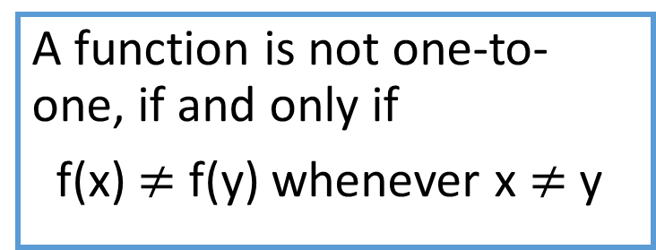
One-to-one functions
One to One Function
Definition
A function is one-to-one if elements in the co-domain has a unique pre-image
a
e
i
o
1
2
3
4
5
a
e
i
o
1
2
3
4
5
A function is not one-to-one, if and only if
f(x) $≠$f(y) whenever x $≠$y
A one-to-one function
A function that is
not one-to-one

Slide 11
More on one-to-one
One to One Function
Injective is synonymous with one-to-one
“A function is injective”
A function is an injection if it is one-to-one
Note that there can be un-used elements in the co-domain
a
e
i
o
1
2
3
4
5
A one-to-one function

Slide 12
More on one-to-one
One to One Function
Determine whether the function f form {a, b, c, d} to {1, 2, 3, 4, 5} with f(a)= 4, f(b)= 5, f(c)= 1, f(d)= 3 is one-to-one or not.
Determine whether the function f(x) = x² from the set of integers to the set of integers is one-to-one?
Determine whether the function f(x) = x+1 from the set of integers to the set of integers is one-to-one?

Slide 13
Onto functions
Definition
A function is onto if each element in the co-domain is an image of some pre-image(s).

Slide 14
Onto functions
Definition
A function is onto if each element in the co-domain is an image of some pre-image
a
e
i
o
u
1
2
3
4
a
e
i
o
1
2
3
4
5
An onto function
A function that is not onto

Slide 15
More on onto
Onto functions
Surjective is synonymous with onto
“A function is surjective”
A function is an surjection if it is onto
Note that there can be multiply used elements in the co-domain
a
e
i
o
u
1
2
3
4
An onto function

Slide 16
More onto
Onto functions
Determine whether the function f form {a, b, c, d} to {1, 2, 3} with f(a)= 3, f(b)= 2, f(c)= 1, f(d)= 3 is onto or not.
Determine whether the function f(x) = x² from the set of integers to the set of integers is onto?
Determine whether the function f(x) = x+1 from the set of integers to the set of integers is onto?

Slide 17
Onto vs. one-to-one
Are the following functions onto, one-to-one, both, or neither?
a
b
c
1
2
3
4
a
b
c
d
1
2
3
4
a
b
c
1
2
3
4
1-to-1, not onto
Both 1-to-1 and onto
Not a valid function
a
b
c
d
1
2
3
a
b
c
d
1
2
3
4
Onto, not 1-to-1
Neither 1-to-1 nor onto

Slide 18
Bijections
Definition
A function that is both one-to-one and onto Such a function is a one-to-one correspondence, or a bijection.
a
b
c
d
1
2
3
4
We only can find the inverse of a function if it is a bijection function.

Slide 19
Bijections
Let f be the function from {a,b,c,d} to {1,2,3,4} with f(a)=4, f(b)=2, f(c)=1 and f(d)=3. Is f bijection?

Slide 20
Identity functions
Definition
A function such that the image and the pre-image are ALWAYS equal
f(x) = 1*x
f(x) = x + 0
The domain and the co-domain must be the same set

Slide 21
Inverse functions
Inverse functions
Let f(x) = 2*x
R
f
R
f⁻¹
f(4.3)
4.3
8.6
f⁻¹(8.6)
Then f⁻¹(x) = x/2

Slide 22
Inverse functions
Definition
Let f be a one-to-one correspondence from the set A to the set B. The inverse function of f is the function that assigns to an element b belonging to B the unique element a in A such that f(a) = b.
The inverse function of f is denoted f⁻¹ .
Hence, f⁻¹ (b) = a when f(a) = b

Slide 23
More on inverse functions
Inverse functions
Can we define the inverse of the following functions?
An inverse function can ONLY be done defined on a bijection
a
b
c
1
2
3
4
a
b
c
d
1
2
3
What is f⁻¹(2)?
Not onto!
What is f⁻¹(2)?
Not 1-to-1!

Slide 24
Few Examples
Few functions
f: Z → Z
f(x) = x
f(x) = 2x
f(x) = x+1
f: R → R
f(x) = 2x
f(x) = x²
f(x) = x³
f: R → R⁺ ∪ {0}
f(x) = x²

Slide 25
Compositions of functions
(f ○ g)(x) = f(g(x))
f ○ g
A
B
C
g
f
g(a)
f(b)
a
f(g(a))
b = g(a)
(f ○ g)(a)

Slide 26
Compositions of functions
Definition
Let g be a function from the set A to the set B and let f be a function from the set B to the set C. The composition of the functions f and g, denoted f o g is defined by
(f o g)(a) = f(g(a))
Note that the composition f o g can not be defined unless the range of g is a subset of the domain of f.

Slide 27
Compositions of functions
Compositions of functions
Let f(x) = 2x+3 Let g(x) = 3x+2
f ○ g
R
R
R
g
f
g(1)
f(5)
f(g(1))=13
1
g(1)=5
(f ○ g)(1)
f(g(x)) = 2(3x+2)+3 = 6x+7

Slide 28
Compositions of functions
Compositions of functions
Does f(g(x)) = g(f(x))?
Let f(x) = 2x+3 Let g(x) = 3x+2
f(g(x)) = 2(3x+2)+3 = 6x+7
g(f(x)) = 3(2x+3)+2 = 6x+11
Function composition is not commutative!
Not equal!

Slide 29
Graphs of functions
f(x)=3
x=1
Let f(x)=2x+1
Plot (x, f(x))
This is a plot
of f(x)
f(x)=5
x=2

Slide 30
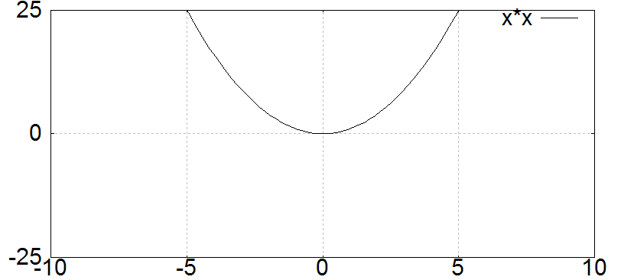
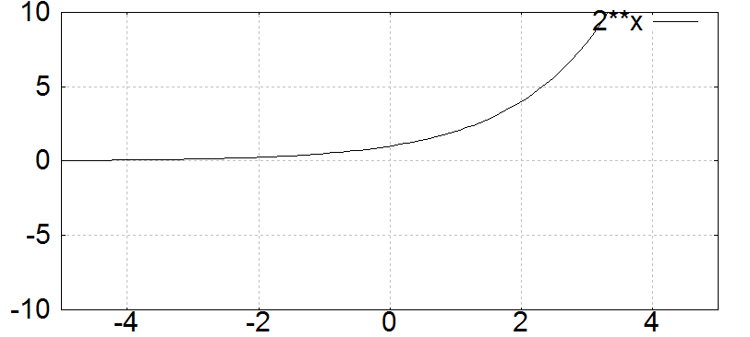
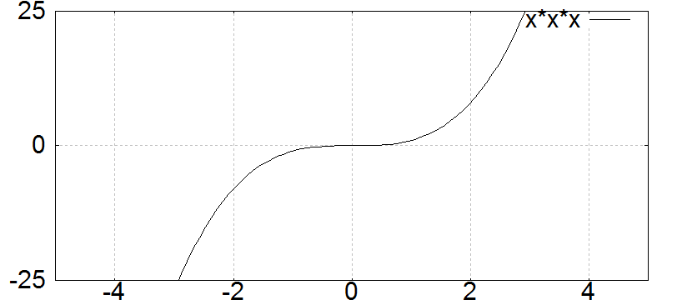
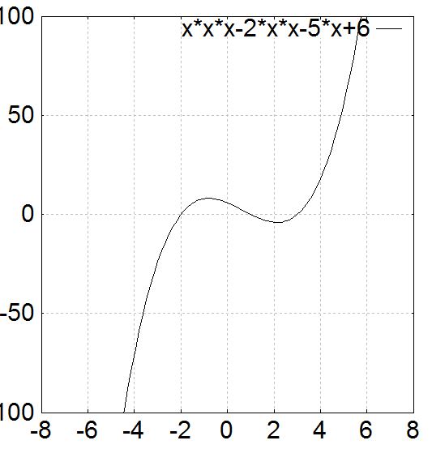
Graphs of functions
Not one-to- one
Not onto
one-to- one
Nor onto
Both one-to- one
and onto
Not one-to- one
But onto

Slide 31
Useful functions
Floor: ⎣x⎦ means take the greatest integer less than or equal to the number
Ceiling: ⎡x⎤ means take the lowest integer greater than or equal to the number
round(x) = ⎣ x+0.5 ⎦

Slide 32
Floor, Ceiling Examples
Find these values
⎣1.1⎦
⎡1.1⎤
⎣-0.1⎦
⎡-0.1⎤
1
2
-1
0

